Slide 1
Chapter 4 Health and Wellness Tourism Destinations
Dr. Bendegul Okumus
Heather Linton Kelly

Slide 2
Learning Outcomes
Explain the historic town of Bath
Define wellness destination
List several other historical wellness destinations
Identify main wellness regions globally
Identify the top wellness destinations in the USA
Identify the top wellness destinations globally

Slide 3
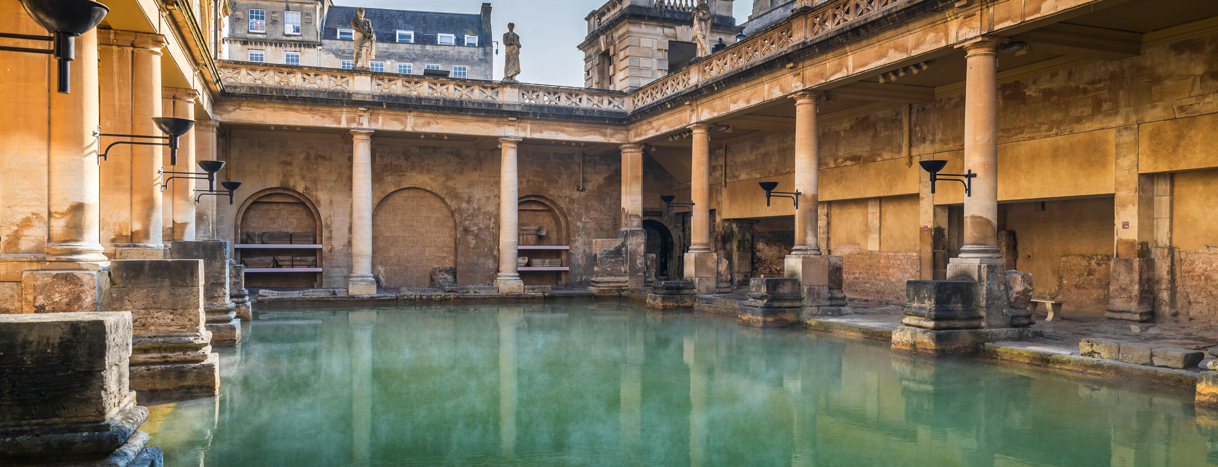
Case Study: Visit Bath: Spas Ancient and Modern
Click here to learn more about the Roman Baths at Bath.

Slide 4
Wellness Destinations
Tourist destination: A country, state, region, city, or town which is marketed or markets itself as a place for tourists to visit
Wellness destination: A country, state, region, city, town, or event that tourists and local residents visit to improve their holistic health
Developing country: One with a standard of living or level of industrial production well below that which is possible with financial or technical aid

Slide 5
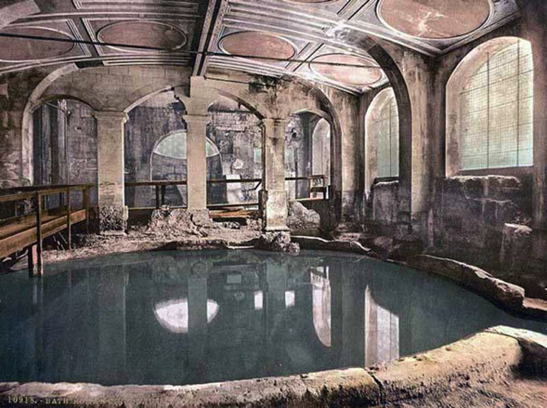
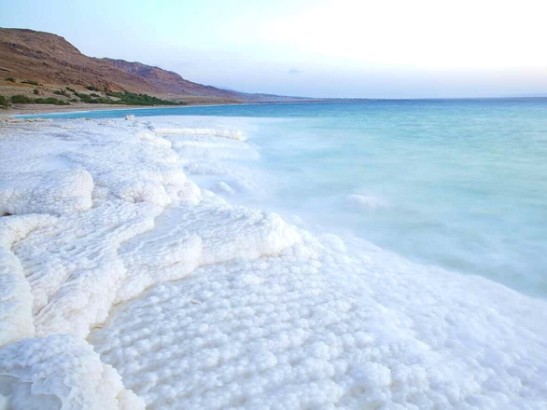
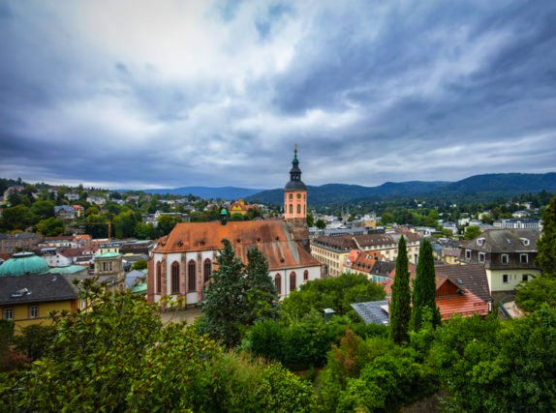
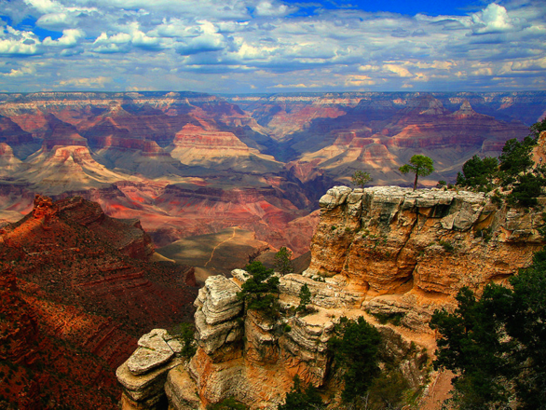
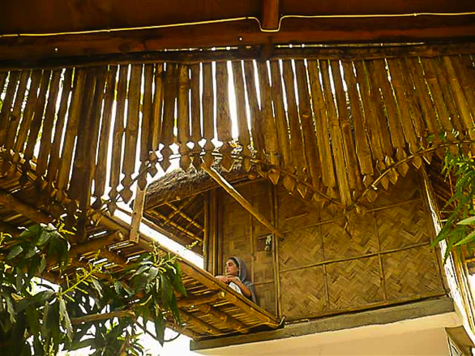
Historical Wellness Tourism Regions and Destinations
Ancient Greece and Rome
The Dead Sea
Baden-Baden region of Germany
Sedona, Arizona
India

Slide 6
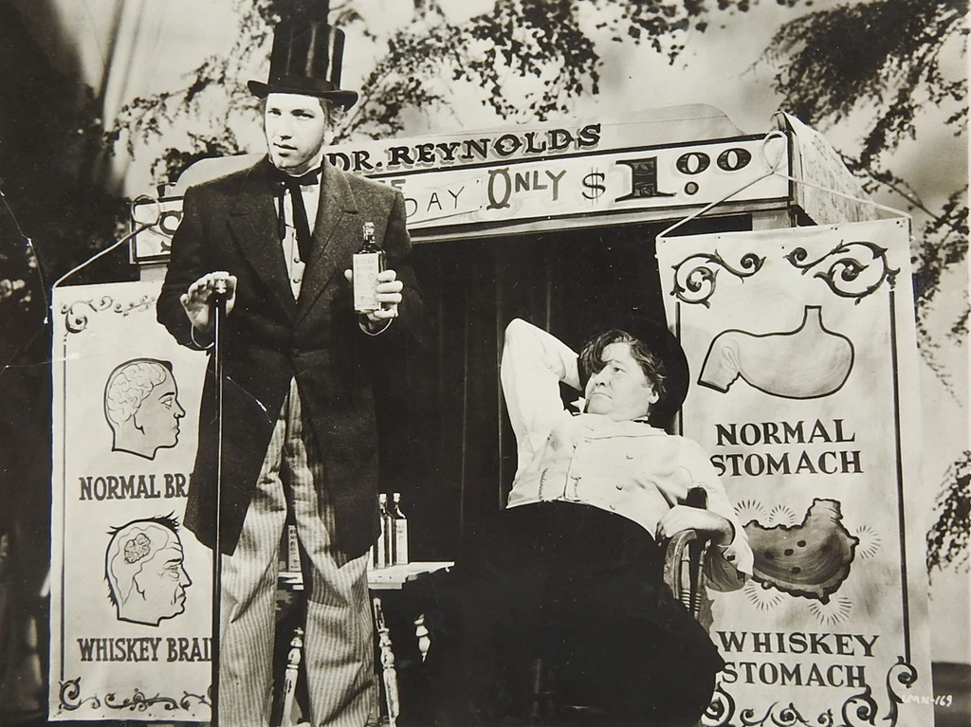
Quack Cures
As seen in the Battle Creek Sanitarium in Michigan and McMichael Institute in Niagara Falls

Slide 7
Emerging Wellness Tourism Regions and Destinations
Asia-Pacific Region
China: fastest-growing market for wellness tourism trips
Not well known for medical tourism but Malaysia, Singapore, South Korea, Thailand and the Philippines offer traditional healing techniques
Latin America-Caribbean Region
Mexico: top wellness tourism destination in the region
Mexico, Cuba, and Colombia: strong reputations for medicine and surgery

Slide 8
Emerging Wellness Tourism Regions and Destinations
Middle East-North Africa Region
United Arab Emirates, Morocco, and Israel are popular destinations in the region
Many destinations in this region focus on spas
Sub-Saharan Africa Region
South Africa: top wellness tourism destination in the region
Known for beach destinations and spafaris

Slide 9
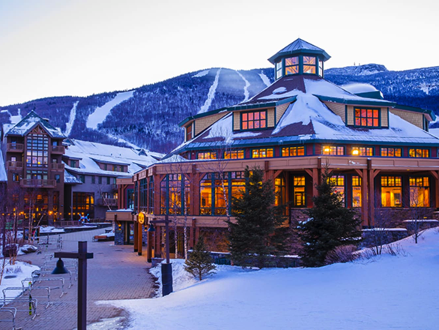
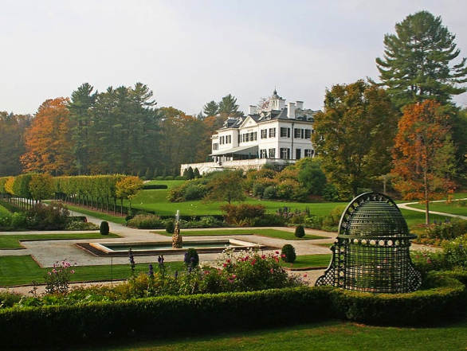
Top Wellness Destinations in the USA
Sedona, Arizona
Amelia Island, Florida
Palm Springs, California
Stowe, Vermont
Lenox, Massachusetts

Slide 10
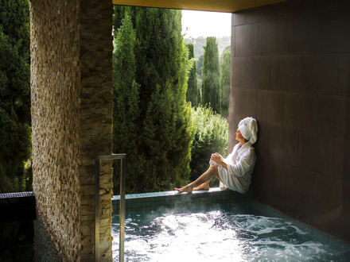
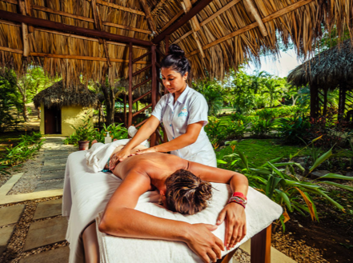
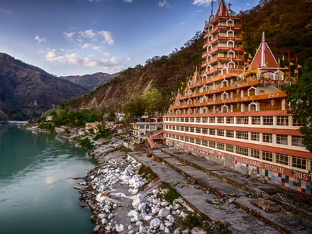
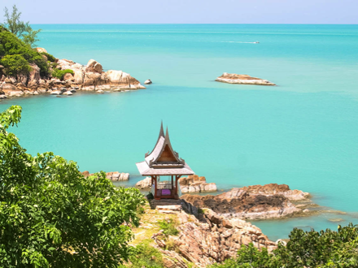
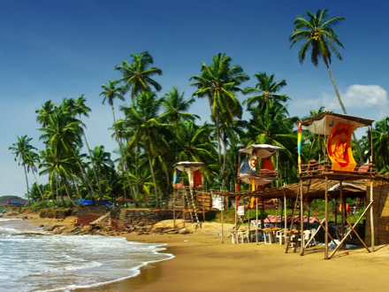
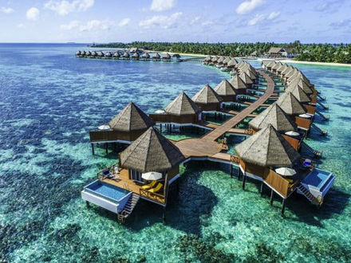
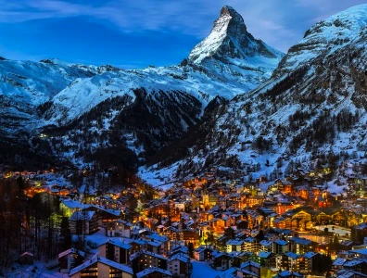
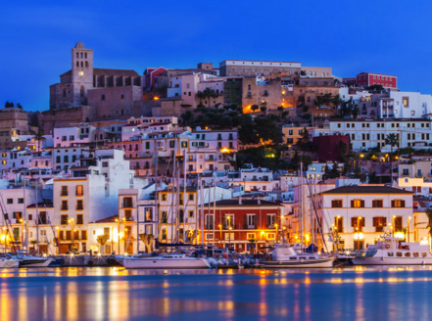
Top Wellness Destinations Globally
Bali, Indonesia
Hepburn Springs, Australia
Costa Rica
Rishikesh, India
Ko Samui, Thailand
Goa, India
Maldives
Zermatt, Switzerland
Ibiza, Spain

Slide 11
Summary
The Roman Baths at Bath is one of the most well known wellness destinations in the world.
There is a different between a tourist destination and a wellness destination.
In a developing country turns to tourism to help build their economy.
Historical wellness tourism regions include: ancient Rome and Greece, the Dead Sea, Baden-Baden region of Germany, Sedona, AZ, and India.

Slide 12
Summary
Miracle Cures in the US in the 1800s were found at the Battle Creek Sanitarium in Michigan and McMichael Institute in Niagara Falls.
Emerging wellness tourism regions include: Asia-Pacific, Latin American-Caribbean, Middle East-North Africa, and Sub-Saharan Africa.
Top Wellness Destination in the US include: Sedona, AZ, Amelia Island, FL, Palm Springs, CA, Stowe, VT, and Lenox, MA.

Slide 13
Summary
Top Wellness Destinations Globally include: Bali, Indonesia, Rishikesh, India, Hepburns Spring, Australia, Ko Samui, Thailand, Costa Rica, Goa, India, Zermatt, Switzerland, The Maldives, and Ibiza, Spain.

